Slide 1
Vinho da ‘Ville
A Charlottesville Wine Story
Michael Kolonay - Jordan Machita - Stephen Morris - Siddharth Surapeneni

Slide 2
Agenda
Background
Executive Summary
Data Background
White Wines Analysis
Red Wines Analysis
Conclusion

Slide 3
Background - Vinho da ‘Ville
New winery planning to open next year in Charlottesville
Niche market for high quality Portuguese wine
Quality 7 or higher
Goals:
Understand and differentiate characteristics of Portuguese wine
Generate predictive model for best quality
Precision – distinguishing high quality wines
True Positive vs. False Positive

Slide 4
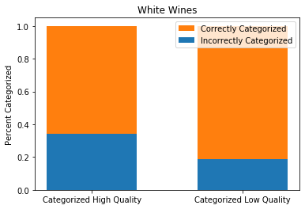
Executive Summary
White Wines
Alcohol Content (increase -> high quality)
Residual Sugars (increase -> high quality)
Chlorides (decrease -> high quality)
Density (decrease -> high quality)
White Wines
55% Threshold | Categorized as Low | Categorized as High
True Low Quality Wines | 1848 | 58
True High Quality Wines | 431 | 112
Note: Figures in green are categorized correctly; those in red are categorized incorrectly.

Slide 5
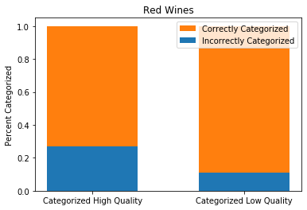
Executive Summary
Red Wines
Alcohol Content (increase -> high quality)
Sulphates (increase -> high quality)
Volatile Acidity (decrease -> high quality)
Red Wines
45% Threshold | Categorized as Low | Categorized as High
True Low Quality Wines | 676 | 11
True High Quality Wines | 83 | 30
Note: Figures in green are categorized correctly; those in red are categorized incorrectly.

Slide 6
Data Background
Source: UCI Machine Learning Repository
https://archive.ics.uci.edu/ml/datasets/wine+quality
1599 red, 4898 white wines
1 response variable: Quality
Categorical:
“High” = 7 or higher
“Low” = 6 or lower
11 predictor variables:
Alcohol
Residual Sugars
Density
Total Sulphur Dioxide
Free Sulphur Dioxide
Sulphates
Fixed Acidity
Volatile Acidity
Citric Acid
Chlorides
pH

Slide 7
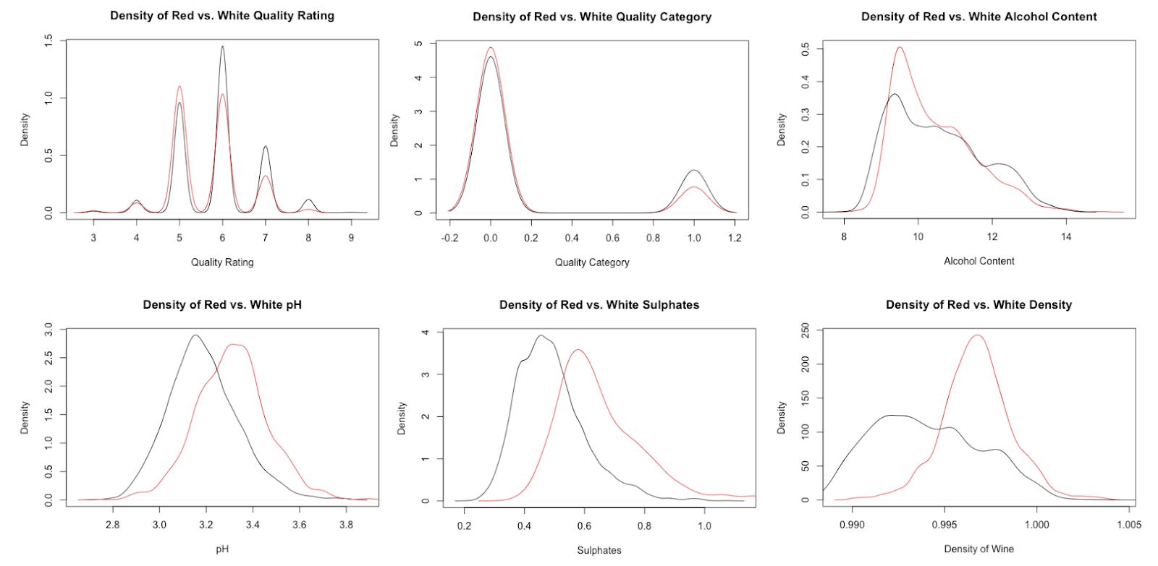
Data Background

Slide 8
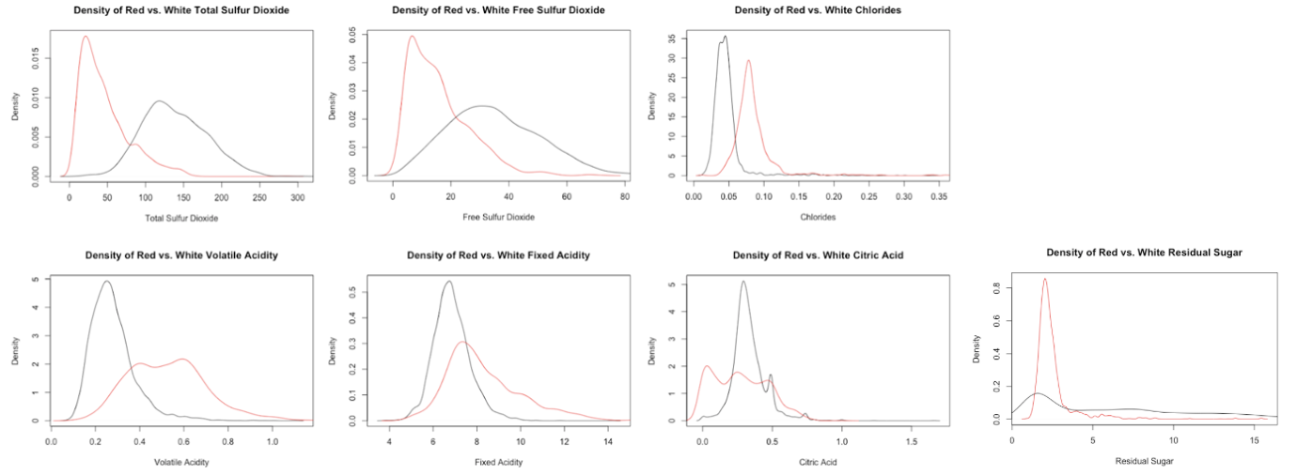
Data Background

Slide 9
Data Background

Slide 10
White Wines – Exploratory data Analysis
4898 wines:
1060 high quality
3838 low quality
Goal:
Predict high quality wines
Minimize false positives

Slide 11
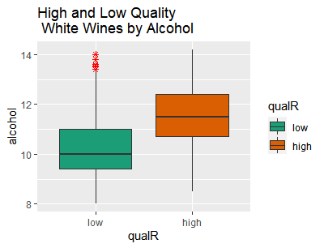
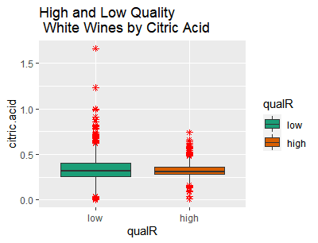
White Wines – Exploratory data Analysis
Boxplots of Alcohol and Citric Acid by Quality

Slide 12
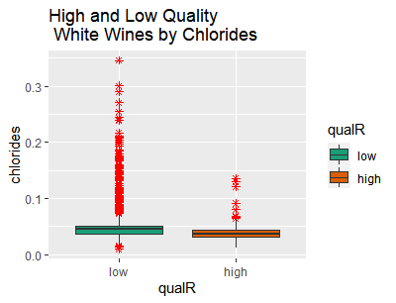
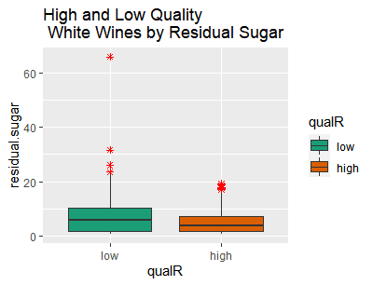
White Wines – Exploratory data Analysis
Boxplots of Chlorides and Residual Sugar by Quality

Slide 13
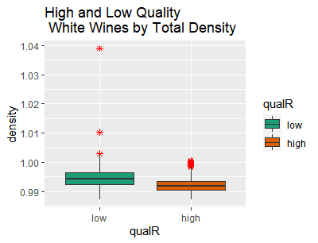
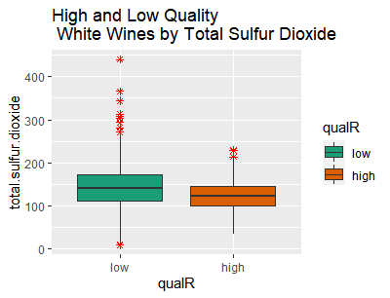
White Wines – Exploratory data Analysis
Boxplots of Density and Total Sulfur Dioxide by Quality

Slide 14
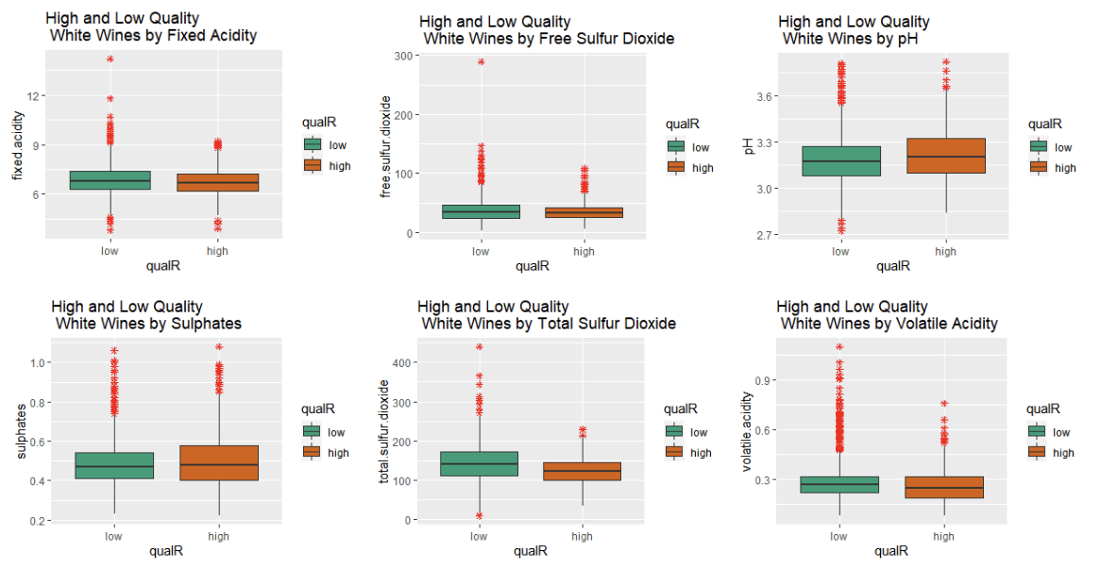
White Wines – Exploratory data Analysis
Boxplots of Remaining Predictors by Quality

Slide 15
White Wines – Detailed Analysis
2 methods:
Full model, backward elimination
EDA predictors, backward elimination
Comparison of Method 1 and 2 Results:
Model | Threshold | Confusion | Sensitivity | Specificity | Accuracy | Precision
Method 1: Full | .55 | FALSE TRUE 0 1833 73 1 422 121 | 0.2228361 | 0.9616999 | 0.7978767 | 0.6237113
Method 2: EDA | .55 | FALSE TRUE 0 1848 58 1 431 112 | 0.2062615 | 0.9695698 | 0.8003267 | 0.6588235

Slide 16
White Wines – Detailed Analysis
Method 1: Full model, backward elimination
Step | AUC | Confusion(.5) | Sensitivity | Specificity | Accuracy | Precision | dropped
0 | 0.7939588 | FALSE TRUE 0 1819 98 1 388 144 | 0.270677 | 0.9488785 | 0.801552 | 0.5827338
1 | 0.7939153 | FALSE TRUE 0 1789 117 1 381 162 | 0.298343 | 0.9386149 | 0.796652 | 0.5806452 | alcohol
2 | 0.7937192 | FALSE TRUE 0 1790 116 1 376 167 | 0.307551 | 0.9391396 | 0.799102 | .590106 | citric.acid
3 | 0.7943926 | FALSE TRUE 0 1789 117 1 376 167 | 0.307551 | 0.9386149 | 0.798693 | 0.5880282 | Total Sulfur dioxide

Slide 17
White Wines – Detailed Analysis
Method 1: Full model, backward elimination
Model Summary
 | Estimate | Std. Error | z value | Pr(>|z|)
(Intercept) | 7.33E+02 | 4.83E+01 | 15.167 | < 2e-16 ***
fixed.acidity | 6.36E-01 | 9.06E-02 | 7.015 | 2.31e-12 ***
volatile.acidity | -3.22E+00 | 6.31E-01 | -5.101 | 3.38e-07 ***
residual.sugar | 3.44E-01 | 2.74E-02 | 12.56 | < 2e-16 ***
chlorides | -1.67E+01 | 5.44E+00 | -3.075 | 0.0021 **
free.sulfur.dioxide | 6.58E-03 | 3.27E-03 | 2.013 | 0.0441 *
density | -7.57E+02 | 4.99E+01 | -15.183 | < 2e-16 ***
pH | 3.70E+00 | 4.74E-01 | 7.81 | 5.70e-15 ***
sulphates | 2.17E+00 | 4.70E-01 | 4.617 | 3.88e-06 ***

Slide 18
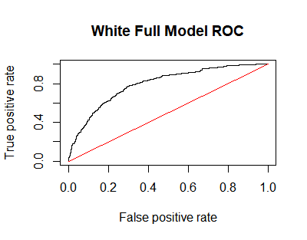
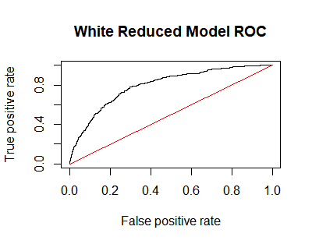
White Wines – Detailed Analysis
Method 1: Full model, backward elimination
Threshold | Confusion | Sensitivity | Specificity | Accuracy | Precision
.5 | FALSE TRUE 0 1789 117 1 376 167 | 0.3075506 | 0.9386149 | 0.7986933 | 0.5880282
.55 | FALSE TRUE 0 1833 73 1 422 121 | 0.2228361 | 0.9616999 | 0.7978767 | 0.6237113
.60 | FALSE TRUE 0 1863 43 1 451 92 | 0.1694291 | 0.9774397 | 0.798285 | 0.6814815

Slide 19
White Wines – Detailed Analysis
Method 2: EDA predictors, backward elimination
Begins with alcohol, citric acid, residual sugar, chlorides, total sulfur dioxide, and density
Step | AUC | Confusion(.5) | Sensitivity | Specificity | Accuracy | Precision | dropped
0 | 0.7572742 | FALSE TRUE 0 1804 102 1 391 152 | 0.279926 | 0.9464848 | 0.798693 | 0.5984252
1 | 0.7573061 | FALSE TRUE 0 1805 101 1 390 153 | 0.281768 | 0.9470094 | 0.79951 | 0.6023622 | citric acid
2 | 0.7581912 | FALSE TRUE 0 1806 100 1 390 153 | 0.281768 | 0.9475341 | 0.799918 | 0.6047431 | total sulfur dioxide
3 | 0.7576863 | FALSE TRUE 0 1802 104 1 382 161 | 0.296501 | 0.9454355 | 0.801552 | 0.6075472 | density

Slide 20
White Wines – Detailed Analysis
Method 2: EDA predictors, backward elimination
Model Summary
 | Estimate Std. | Error | z value | Pr(>|z|)
(Intercept) | 114.6922 | 70.02613 | 1.638 | 0.101453
alcohol | 0.59823 | 0.10116 | 5.914 | 3.34e-09 ***
residual.sugar | 0.09231 | 0.02717 | 3.398 | 0.000680 ***
chlorides | -20.31611 | 5.23858 | -3.878 | 0.000105 ***
density | -122.94871 | 69.73427 | -1.763 | 0.077883 .

Slide 21
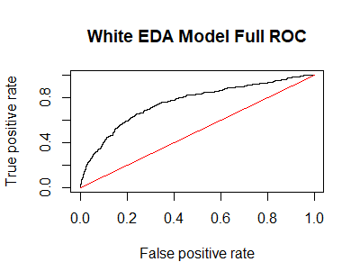
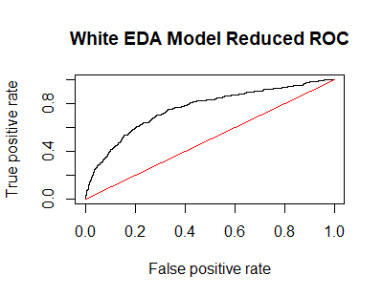
White Wines – Detailed Analysis
Method 2: EDA predictors, backward elimination
Threshold | Confusion | Sensitivity | Specificity | Accuracy | Precision
.5 | FALSE TRUE 0 1806 100 1 390 153 | 0.281768 | 0.9475341 | 0.7999183 | 0.6047431
.55 | FALSE TRUE 0 1848 58 1 431 112 | 0.2062615 | 0.9695698 | 0.8003267 | 0.6588235

Slide 22
Red Wines – Exploratory data Analysis
1599 wines:
113 high quality
687 low quality
Goal:
Predict high quality wines
Minimize false positives

Slide 23
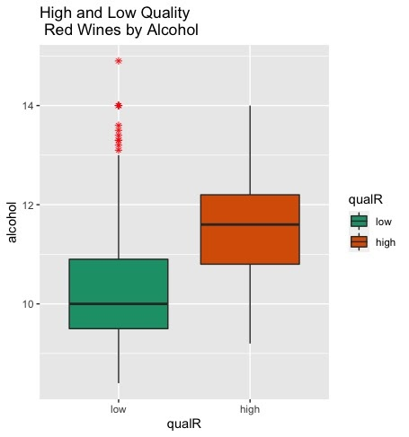
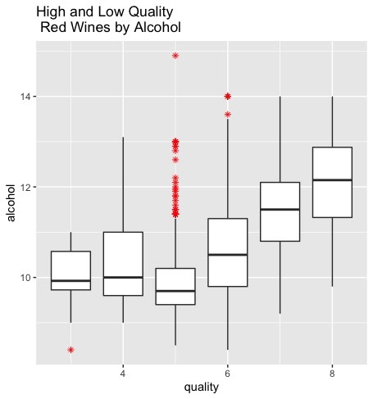
red Wines – Exploratory data Analysis
Boxplots of Alcohol by Quality

Slide 24
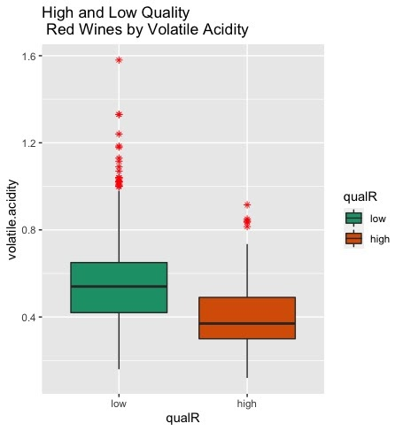
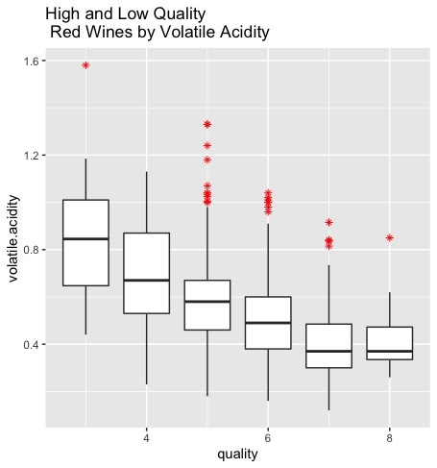
red Wines – Exploratory data Analysis
Boxplots of Volatile Acidity by Quality

Slide 25
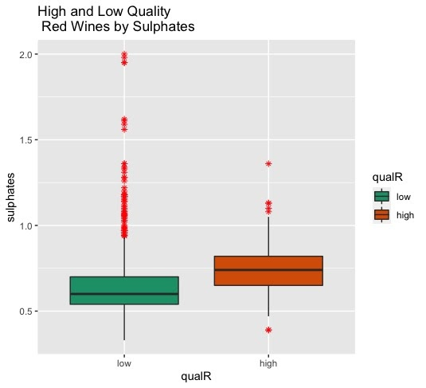
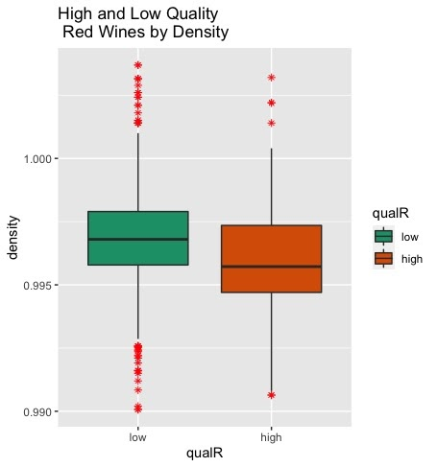
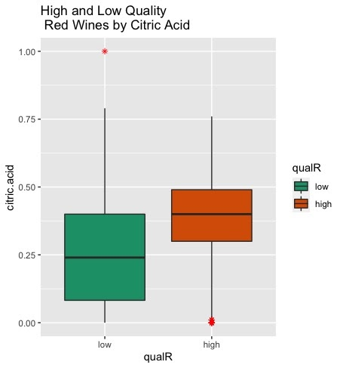
red Wines – Exploratory data Analysis
Boxplots of Sulphates, Density, and Citric Acid by Quality

Slide 26
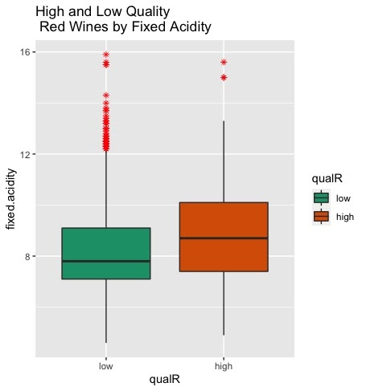
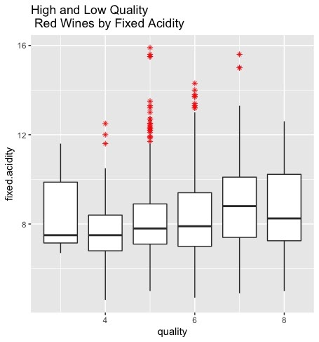
red Wines – Exploratory data Analysis
Boxplots of Fixed Acidity by Quality

Slide 27
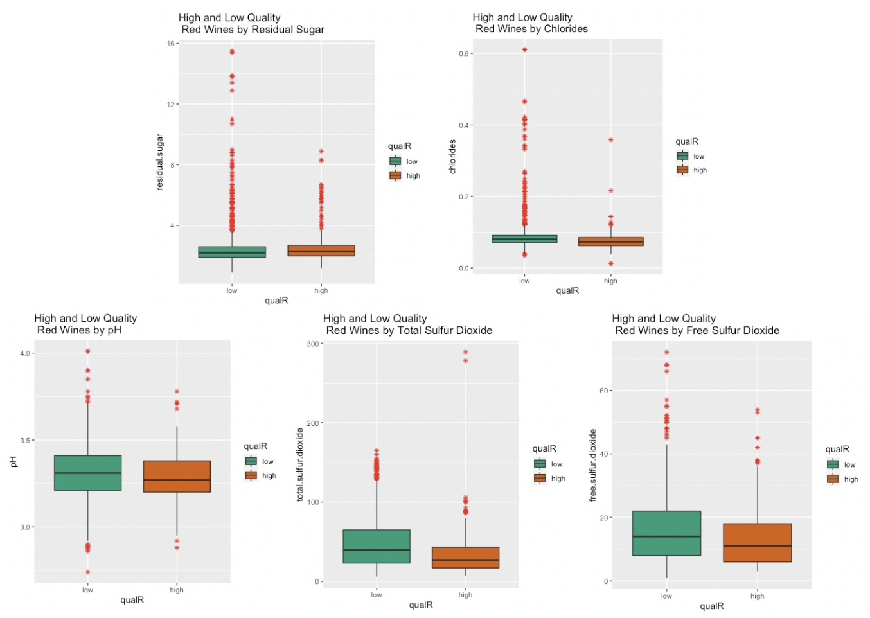
red Wines – Exploratory data Analysis
Boxplots of Remaining Predictors by Quality

Slide 28
red Wines – Detailed Analysis
3 methods:
Full model, backward elimination
EDA predictors, backward elimination
Adjusted version of (2), revisiting EDA
Comparison of Method 1, 2, and 3 Results:
Model | Threshold | Confusion | Sensitivity | Specificity | Accuracy | Precision
Method 1: Full | .50 | FALSE TRUE 0 669 18 1 79 34 | 0.3008 | 0.973 | 0.87875 | 0.6538
Method 2: EDA | .50 | FALSE TRUE 0 679 8 1 90 23 | 0.2035 | 0.9884 | 0.8775 | 0.7419355
Method 3: EDA Adjusted | 0.45 | FALSE TRUE 0 676 11 1 83 30 | 0.2655 | 0.98399 | 0.8825 | 0.7317

Slide 29
red Wines – Detailed Analysis
Method 1: Full model, backward elimination
Step | AUC | Confusion(.5) | Sensitivity | Specificity | Accuracy | Precision | dropped
0 | 0.8902758 | FALSE TRUE 0 672 15 1 76 37 | 0.3274336 | 0.9781659 | 0.88625 | 0.7115385
1 | 0.8902629 | FALSE TRUE 0 672 15 1 77 36 | 0.3185841 | 0.9781659 | 0.885 | 0.7058824 | pH
2 | 0.8900826 | FALSE TRUE 0 672 15 1 77 36 | 0.3185841 | 0.9753266 | 0.885 | 0.7058824 | free sulfur dioxide
3 | 0.8914222 | FALSE TRUE 0 673 14 1 77 36 | 0.3185841 | 0.9796215 | 0.88625 | 0.72 | citric acid
4 | 0.8895802 | FALSE TRUE 0 669 18 1 79 34 | 0.300885 | 0.9737991 | 0.87875 | 0.6538462 | density

Slide 30
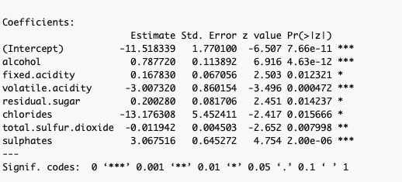
red Wines – Detailed Analysis
Method 1: Full model, backward elimination

Slide 31
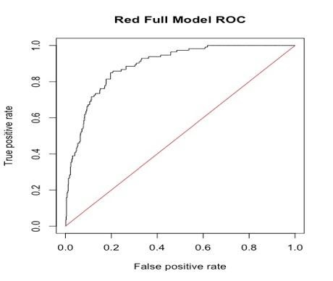
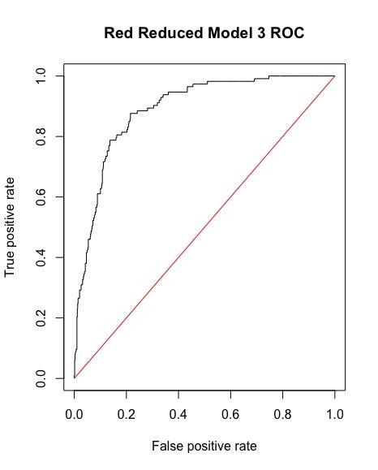
red Wines – Detailed Analysis
Method 1: Full model, backward elimination
Threshold | Confusion | Sensitivity | Specificity | Accuracy | Precision
.55 | FALSE TRUE 0 678 9 1 87 26 | 0.2300885 | 0.9868996 | 0.88 | 0.7428571
.50 | FALSE TRUE 0 669 18 1 79 34 | 0.3008 | 0.973 | 0.87875 | 0.6538
.45 | FALSE TRUE 0 662 25 1 75 38 | 0.3362832 | 0.9636099 | 0.875 | 0.6031746

Slide 32
red Wines – Detailed Analysis
Method 2: EDA predictors, backward elimination
Begins with Alcohol, Volatile Acidity, Citric Acid, Density, and Sulphates
Step | AUC | Confusion(.5) | Sensitivity | Specificity | Accuracy | Precision | dropped
0 | 0.8839768 | FALSE TRUE 0 678 9 1 91 22 | 0.1946 | 0.9869 | 0.875 | 0.7096774
1 | 0.8840541 | FALSE TRUE 0 679 8 1 90 23 | 0.2035 | 0.9884 | 0.8775 | 0.7419355 | density

Slide 33
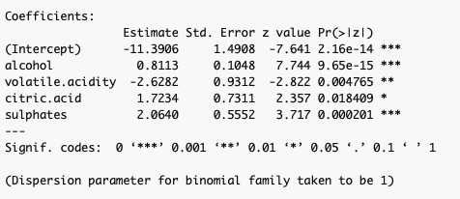
red Wines – Detailed Analysis
Method 2: EDA predictors, backward elimination

Slide 34
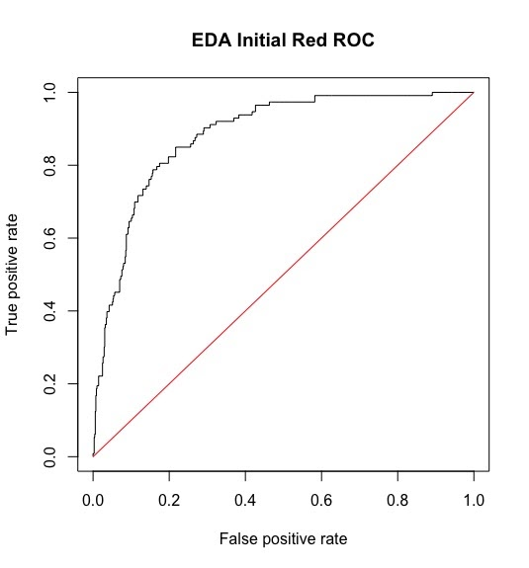

red Wines – Detailed Analysis
Method 2: EDA predictors, backward elimination
Threshold | Confusion | Sensitivity | Specificity | Accuracy | Precision
.55 | FALSE TRUE 0 683 4 1 95 18 | 0.15929 | 0.99417 | 0.875 | 0.8181
.50 | FALSE TRUE 0 679 8 1 90 23 | 0.20353 | 0.9884 | 0.8775 | 0.7419355
.45 | FALSE TRUE 0 670 17 1 86 27 | 0.238938 | 0.9752547 | 0.87125 | 0.613636

Slide 35
red Wines – Detailed Analysis
Method 3: Adjusted EDA predictors, backward elimination
Begins with Alcohol, Volatile Acidity, Density, Sulphates, and Residual Sugars
Step | AUC | Confusion(.5) | Sensitivity | Specificity | Accuracy | Precision | dropped
0 | 0.8855741 | FALSE TRUE 0 680 7 1 91 22 | 0.2300885 | 0.9898108 | 0.8775 | 0.7586207
1 | 0.88645 | FALSE TRUE 0 682 5 1 92 21 | 0.1858407 | 0.992722 | 0.87875 | 0.8076923 | density
2 | 0.8874934 | FALSE TRUE 0 682 5 1 94 19 | 0.1681416 | 0.992722 | 0.87625 | 0.7916667 | residual sugar

Slide 36
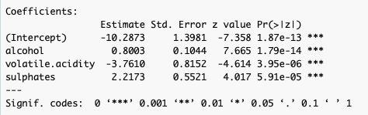
red Wines – Detailed Analysis
Method 3: Adjusted EDA predictors, backward elimination

Slide 37
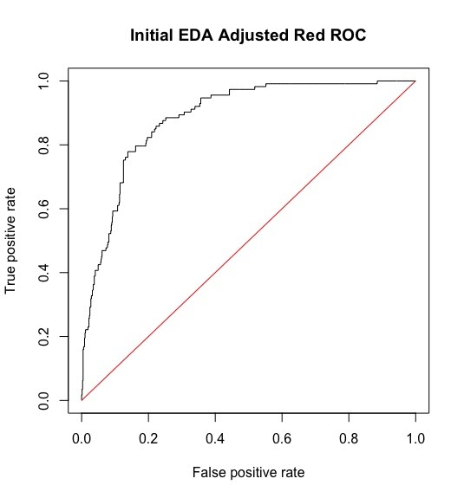
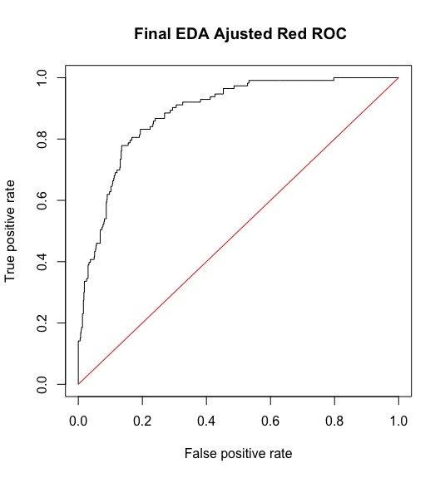
red Wines – Detailed Analysis
Method 3: Adjusted EDA predictors, backward elimination
Threshold | Confusion | Sensitivity | Specificity | Accuracy | Precision
0.45 | FALSE TRUE 0 676 11 1 83 30 | 0.2655 | 0.98399 | 0.8825 | 0.7317
0.50 | FALSE TRUE 0 682 5 1 94 19 | 0.1681416 | 0.992722 | 0.87625 | 0.7916667
0.55 | FALSE TRUE 0 685 2 1 97 16 | 0.1416 | 0.997 | 0.87625 | 0.888

Slide 38
Conclusion
EDA yielded better predictive models than starting with full models
Thresholds optimized for precision while still leaving a sufficient population of wines
Final Results:
Type | Predictors | Threshold | Confusion | Sensitivity | Specificity | Accuracy | Precision
White | Alcohol Residual Sugar Chlorides Density | .55 | FALSE TRUE 0 1848 58 1 431 112 | 0.2062615 | 0.9695698 | 0.8003267 | 0.658823
Red | Alcohol Volatile Acidity Sulphates | .45 | FALSE TRUE 0 676 11 1 83 30 | 0.2654867 | 0.9839884 | 0.8825 | 0.731707

